Slide 1
Learning Spark
Dingtinghe
dingth@chinatelecom.cn

Slide 2
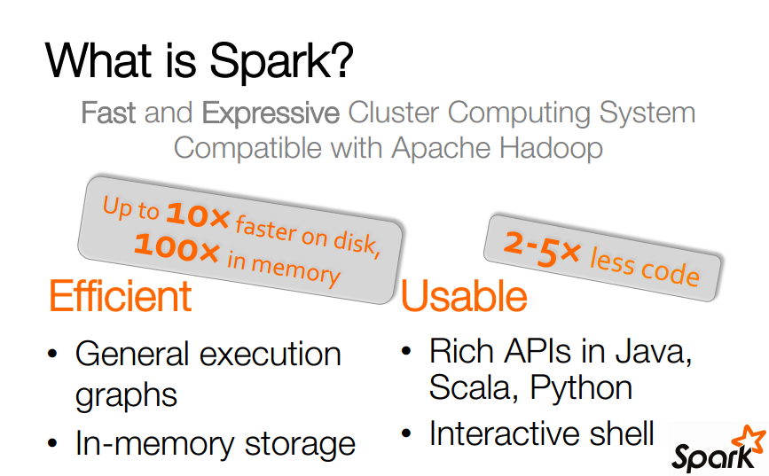

Slide 3
Key Concepts Write programs in terms of transformations on distributed datasets
Resilient Distributed Datasets
Read-only partitioned collections of objects spread across a cluster, stored in RAM or on Disk
Built through parallel transformations
Automatically rebuilt on failure
Users control persistence and partitioning
Operations
• Transformations (Lazy model)
return pointers to new RDDs (e.g. map, filter,groupBy)
• Actions
return values (e.g. count, collect,save)

Slide 4
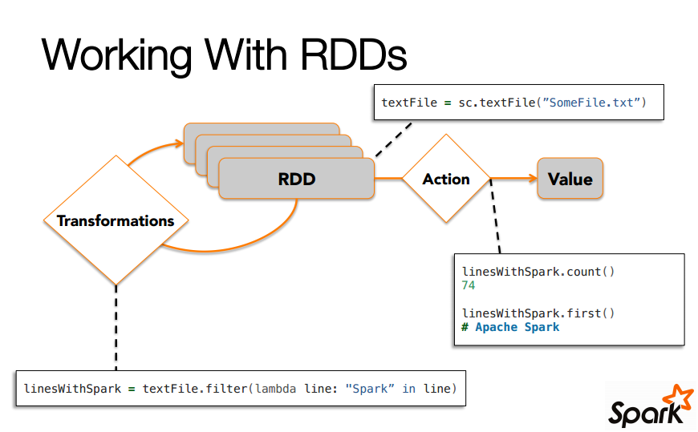

Slide 5
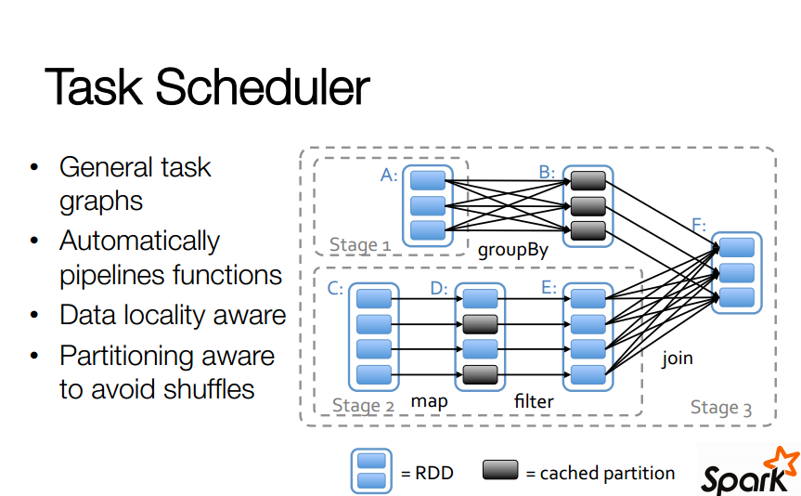

Slide 6
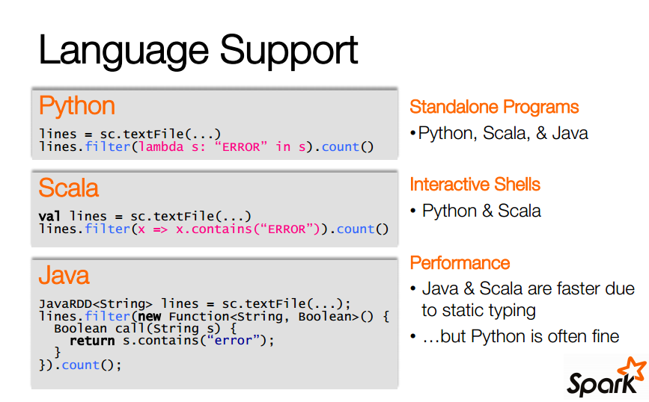
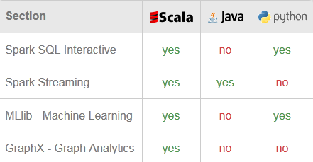

Slide 7
Using the Shell
Launching:
spark-shell
Modes: ./spark-shell local # local, 1 thread ./spark-shell local[2] # local, 2 threads ./spark-shell spark://host:port # cluster
./spark-shell --master yarn-client # on yarn client

Slide 8
Submitting Applications
Yarn client
bin/spark-submit --class org.apache.spark.examples.SparkPi --master yarn-client lib/spark-examples-1.5.1-hadoop2.6.0.jar
Yarn cluster
bin/spark-submit --class org.apache.spark.examples.SparkPi --master yarn-cluster lib/spark-examples-1.5.1-hadoop2.6.0.jar
Local
bin/spark-submit --class org.apache.spark.examples.SparkPi --master local lib/spark-examples-1.5.1-hadoop2.6.0.jar
Standalone
bin/spark-submit --class org.apache.spark.examples.SparkPi --master spark://ip:port lib/spark-examples-1.5.1-hadoop2.6.0.jar

Slide 9
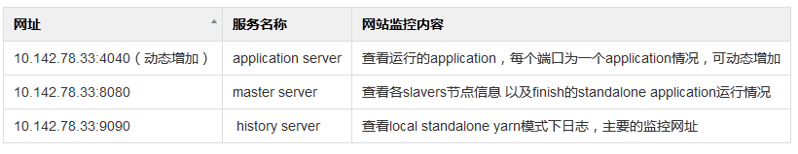
Monitoring

Slide 10
Initializing Spark
Only one SparkContext may be active per JVM.
Spark shell:a special interpreter-aware SparkContext is already created for you, in the variable called sc.

Slide 11
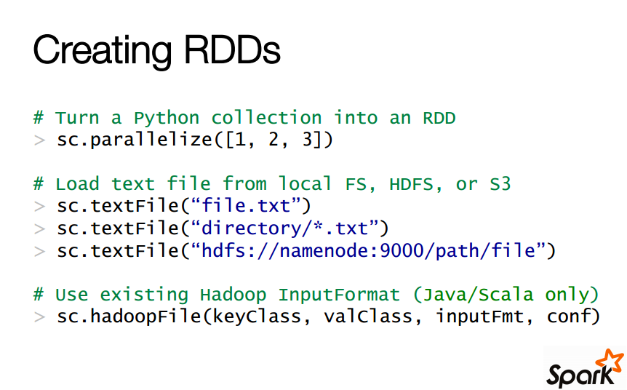
Parallelized Collections
External Datasets

Slide 12
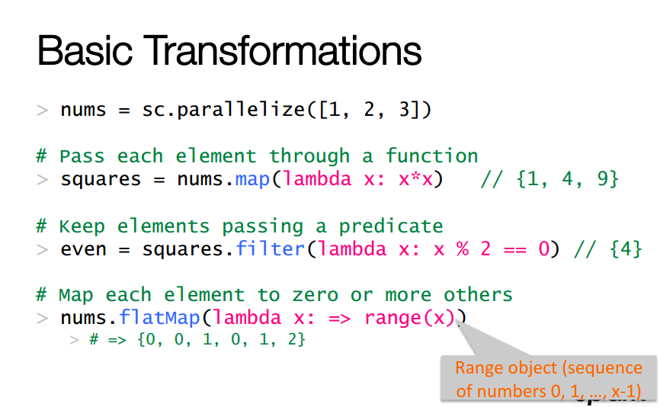

Slide 13
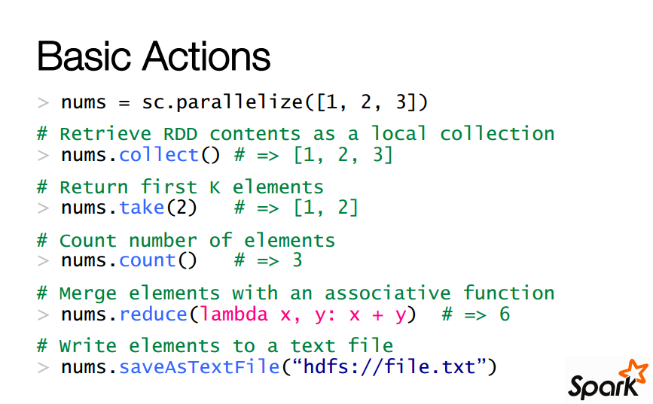

Slide 14
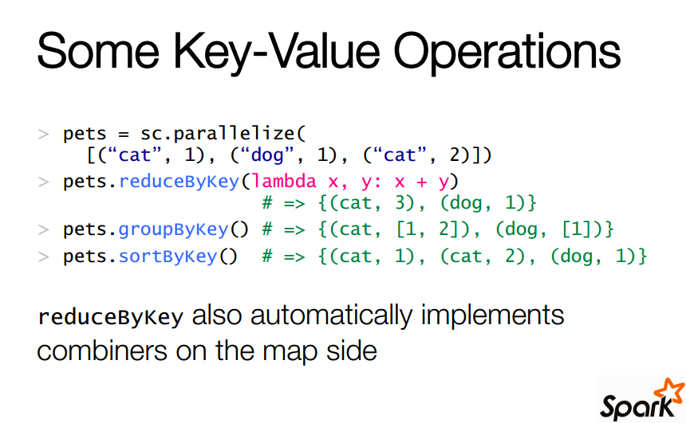

Slide 15
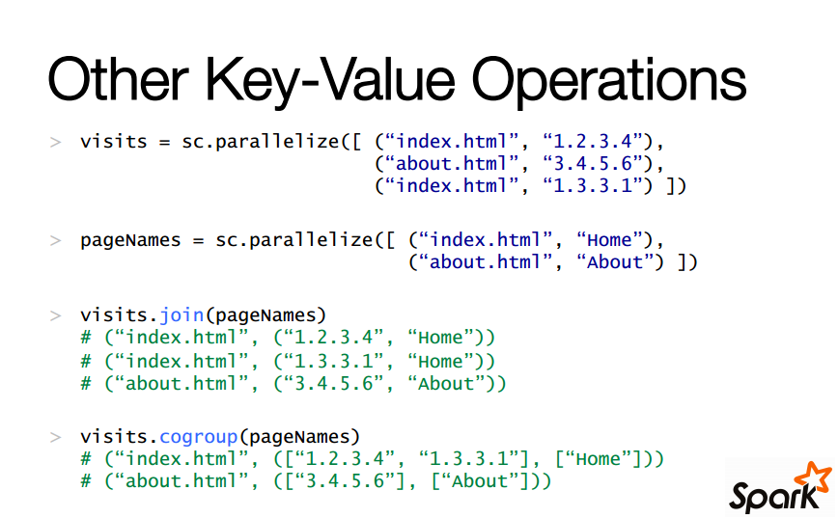

Slide 16
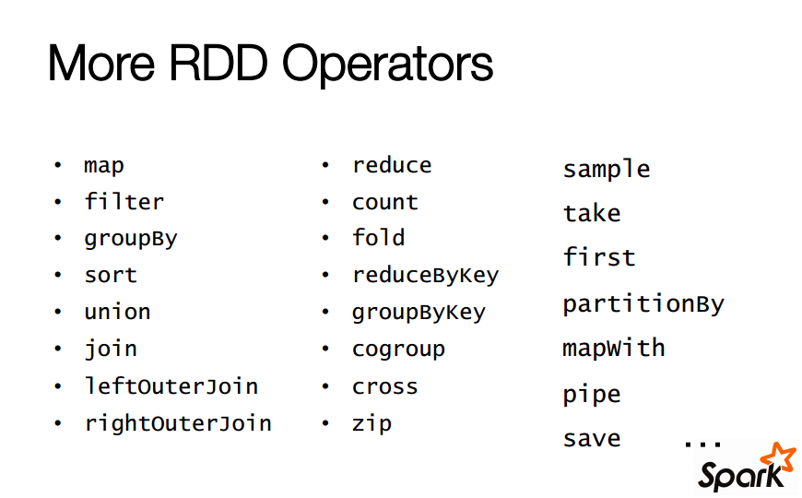

Slide 17
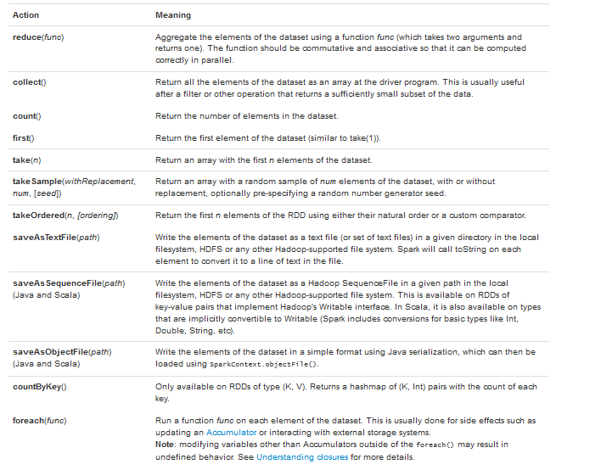

Slide 18
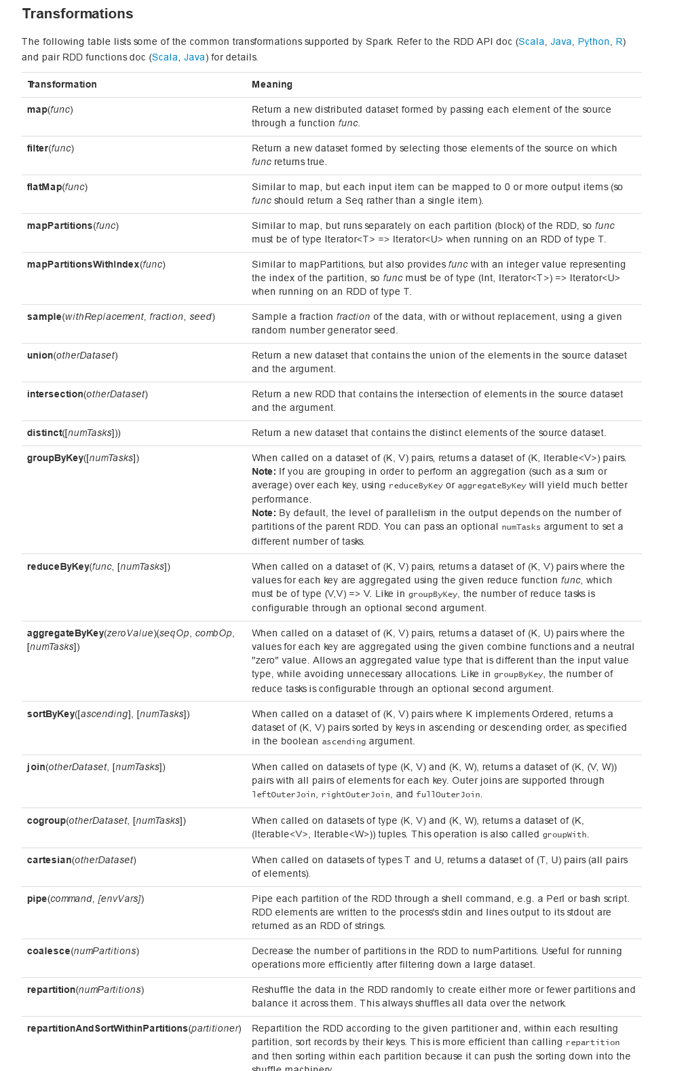

Slide 19
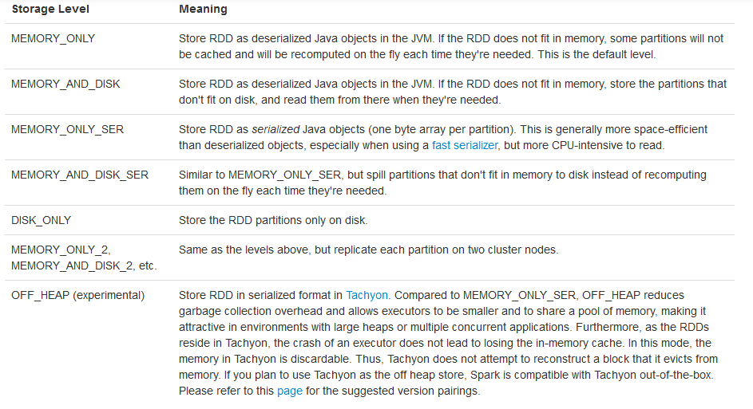
RDD Persistence

Slide 20
The cache() method is a shorthand for using the default storage level,
which is StorageLevel.MEMORY_ONLY (store deserialized objects in memory)
Spark’s cache is fault-tolerant – if any partition of an RDD is lost,
it will automatically be recomputed using the transformations that
originally created it.
Spark also automatically persists some intermediate data in shuffle
operations (e.g. reduceByKey), even without users calling persist.
Choose:
based on memory usage and CPU efficiency.

Slide 21
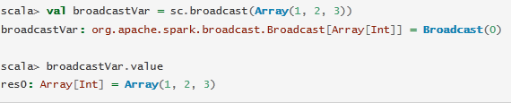
Shared Variables
Broadcast Variables
Broadcast Variables allow the programmer to keep a read-only variable cached on each machine rather than shipping a copy of it with tasks

Slide 22
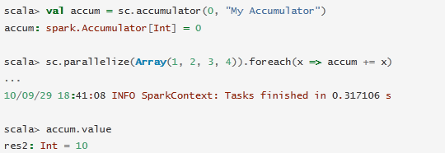
Accumulators
Variables that are only“added”to through an associative operation
Only the driver program can read the accumulator’s value.
For accumulator updates performed inside actions only and Spark guarantees that each task’s update to the accumulator will only be applied once
In transformations, each task’s update may be applied more than once if tasks or job stages are re-executed.
Obey lazy evaluation model. If they are being updated within an operation on an RDD, their value is only updated once that RDD is computed as part of an action.

